Slide 1
SEO Navigator: From Audit to Action
SEO AUDIT

Slide 2

Agenda
TECHNICAL SEO
ON-PAGE SEO
OF-PAGE SEO
SWOT ANALYSIS
KEYWORD RESEARCH
ON-PAGE SEO AUDIT
CURRENT TECHNICAL SEO STATUS
CONTENT STRATEGY
SEO STRATEGY & RECOMMENDATION

Slide 3
Technical seo

Slide 4
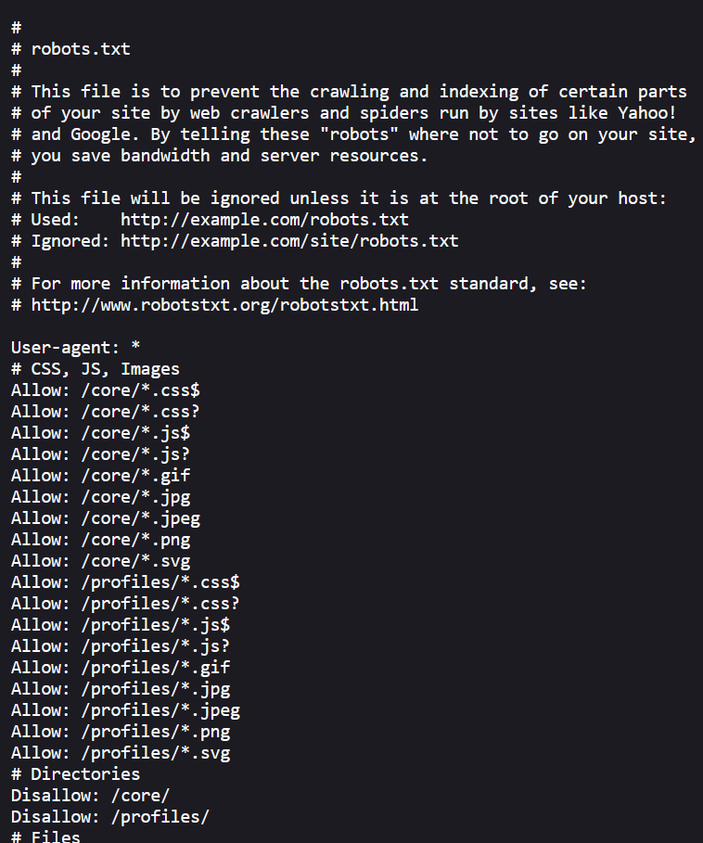
1. CRAWLING & INDEXING
Robots.txt
https://www.techmahindra.com/robots.txt

Slide 5
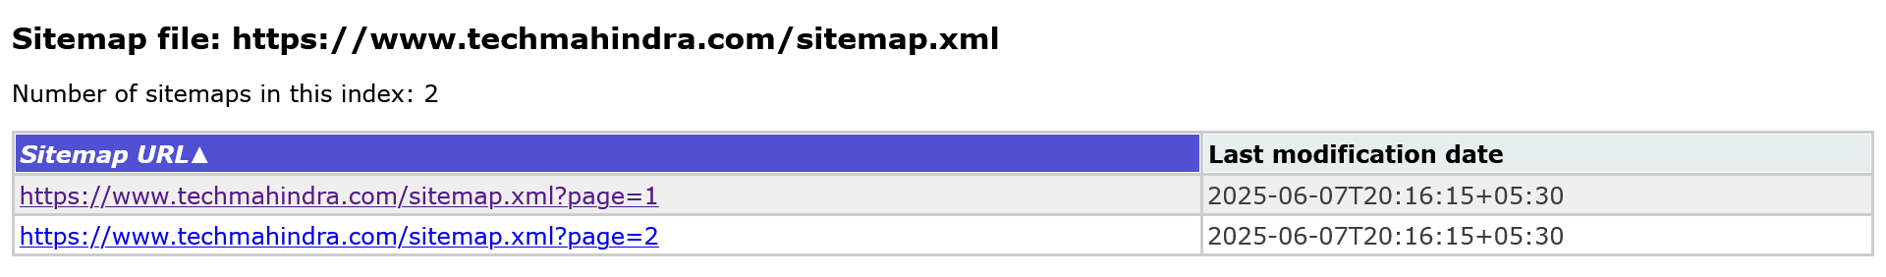
Xml sitemap
https://www.techmahindra.com/sitemap.xml

Slide 6
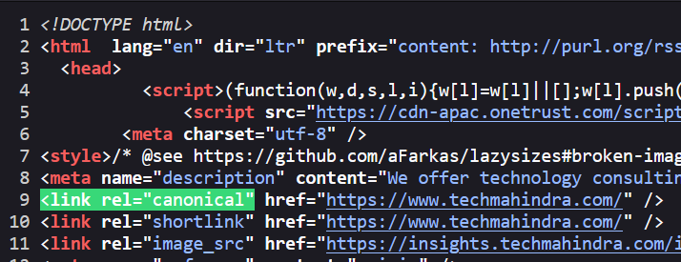
Canonical tag
Its shows orginal pages for duplicate.

Slide 7
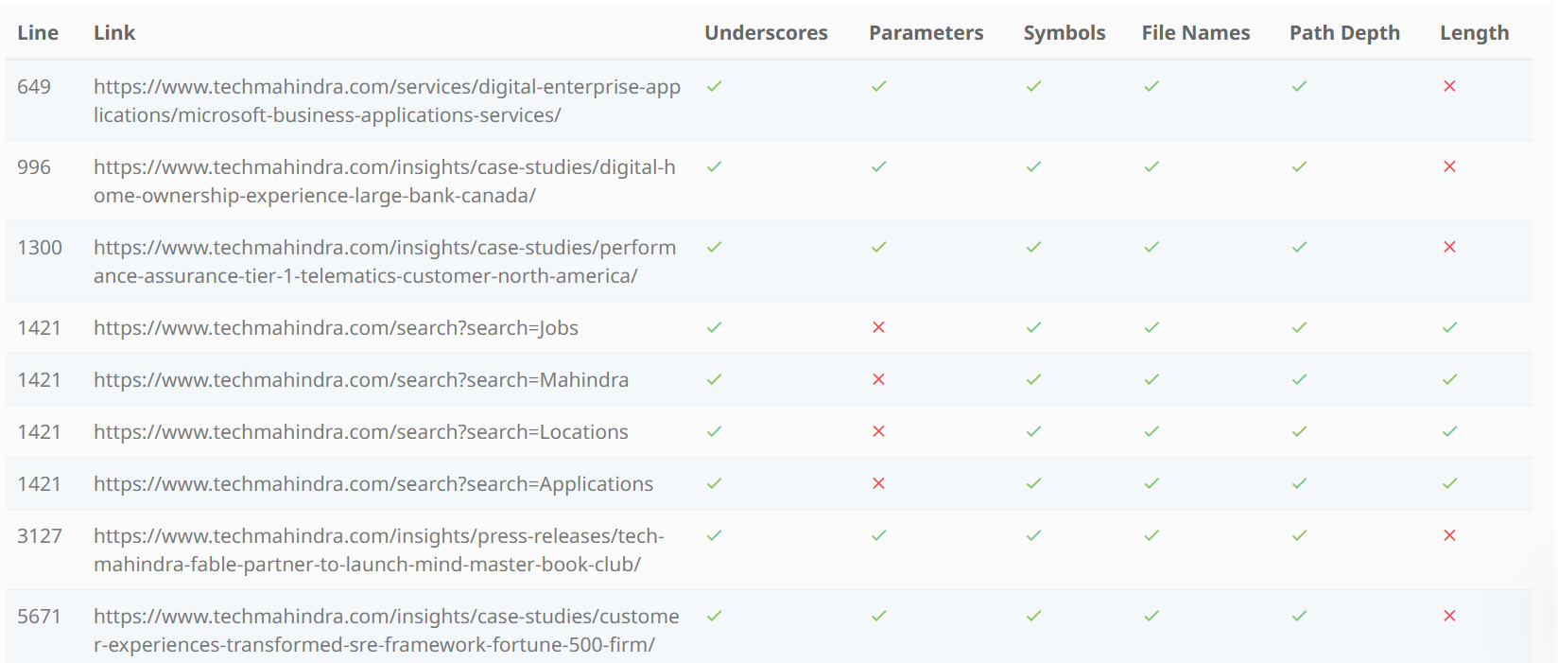
2. URL STRUCTURE

Slide 8
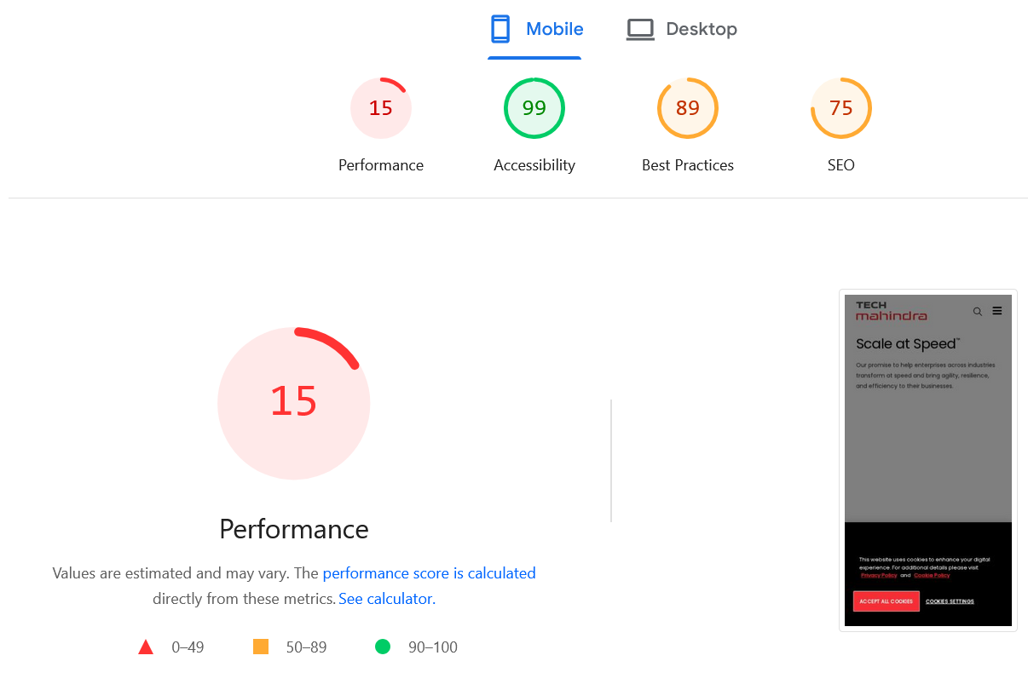
3. Mobile friendlyness

Slide 9
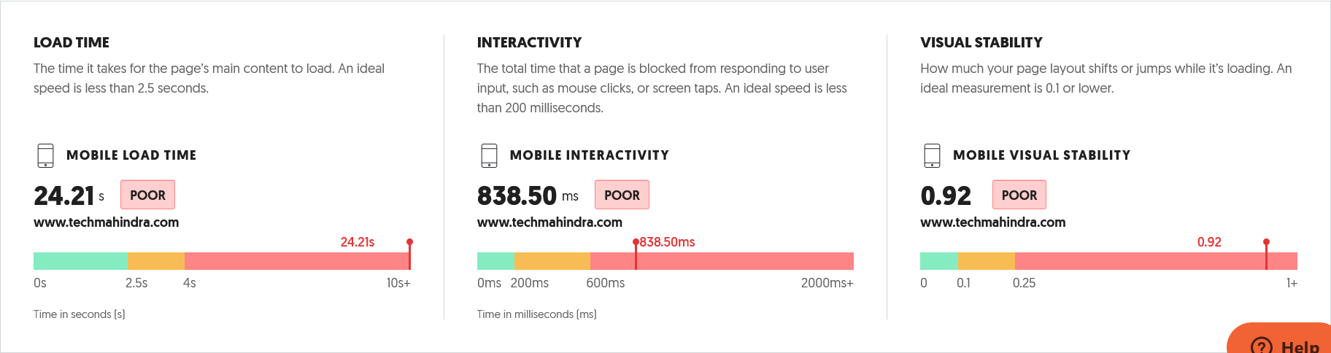
4. PAGE SPEED

Slide 10
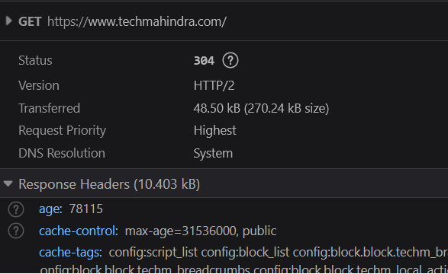

compression

Slide 11


5. https & security
website is secure

Slide 12

6. Redirects & Error Pages

Slide 13
on page seo

Slide 14
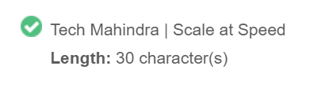
1. Title tag

Slide 15
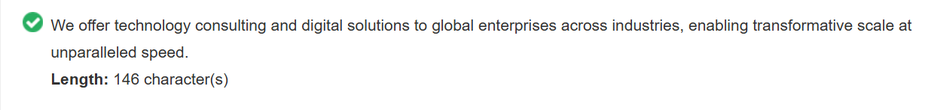
2. Meta description

Slide 16
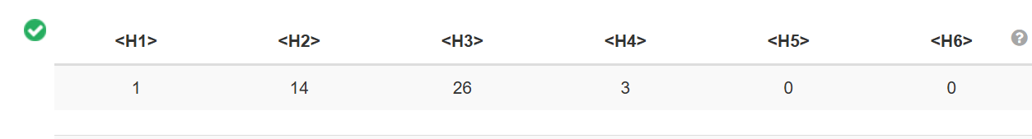
3. Heading tags

Slide 17
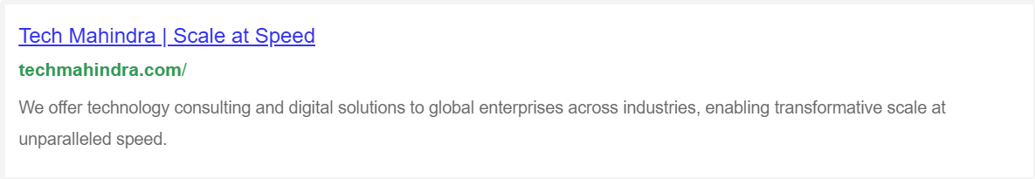
4. google preview

Slide 18
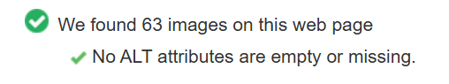
5. Alt attributes

Slide 19
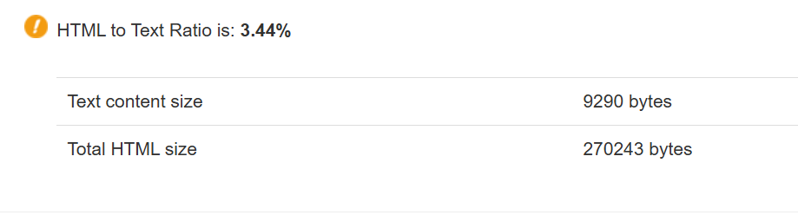
6. Text to html ratio

Slide 20
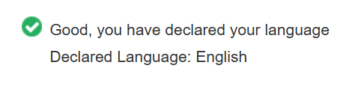
6. Language tag

Slide 21
7. hrefLanguage tag

Slide 22
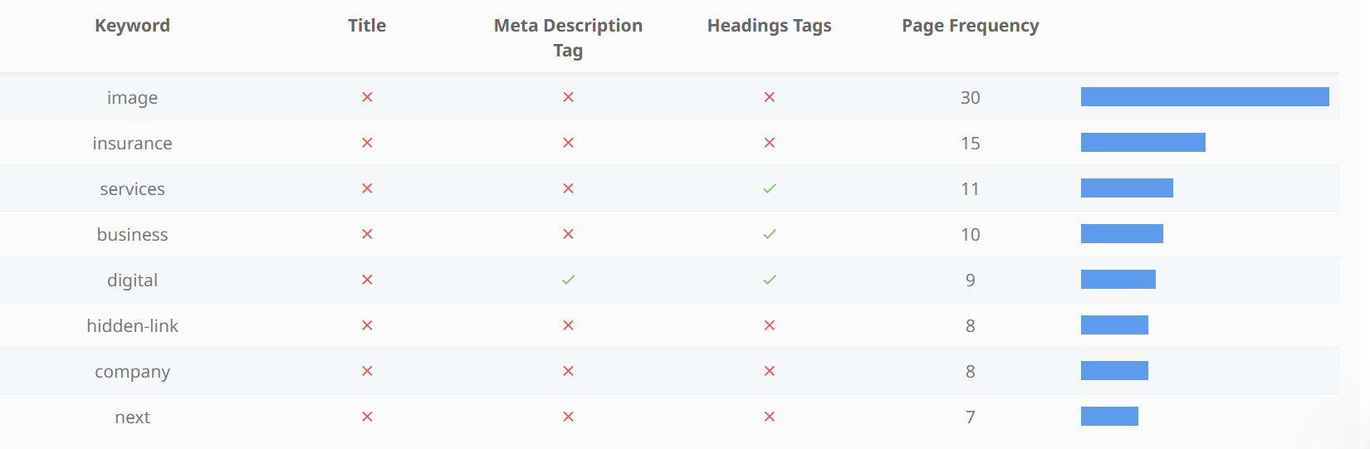
8. Keyword consistency

Slide 23
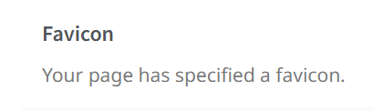
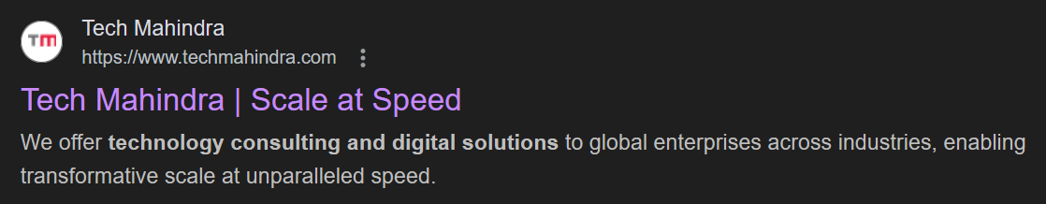
9. favicon

Slide 24
off page seo

Slide 25
1. Social media
Tech Mahindra
X 150k followers
Fb 170k followers
Insta 61.4k followers
Youtube 13k followers

Slide 26
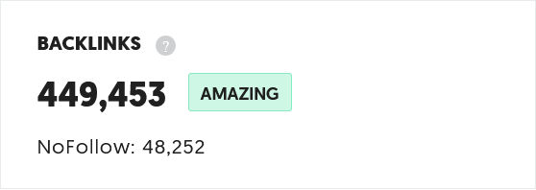

2. backlinks

Slide 27
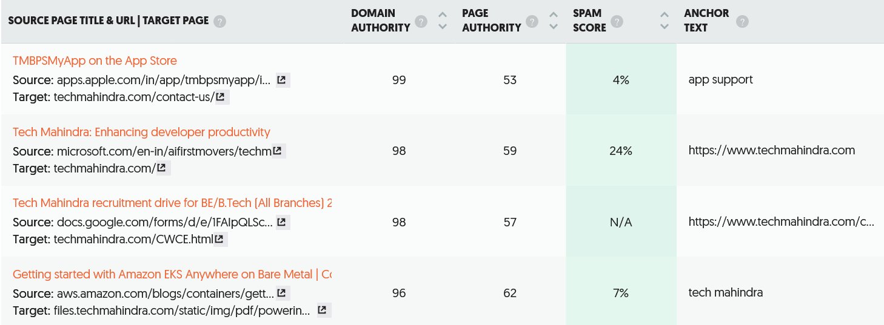
2. backlinks

Slide 28
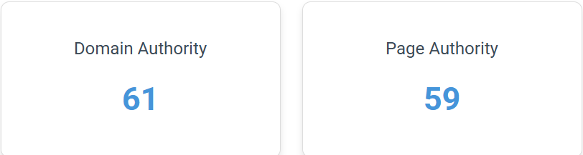
3. Da & pa
Strong authority site

Slide 29

Swot analysis

Slide 30
strength
Strong backlink profiles.
Huge followers on social media.
100% unique content.
Rank on the top of the page.

Slide 31
weakness
Low page speed.
No mobile friendly.
Poor ui/ux design.
Not good url structure.
Low sharing & engagement.
Lower brand recall globally.

Slide 32
opporturnities
Offline webinars Upload on social media.
Off page seo
Target a keywords

Slide 33
threats
Intense competition from TCS, Infosys, Wipro
Higer brand recall globally.

Slide 34

Keyword research

Slide 35
NETWORK SERVICE
KEYWORD | DIFFICULTY | TYPE
network services providers | medium | Transactional / Navigational
Tech Mahindra network services | low | Navigational
Business network solutions | low | Transactional / Informational
What are network services | low | Informational
Cloud network services | low | Informational / Transactional
business services | high | Informational / Transactional
network automation solutions | low | Transactional / Informational
it consulting services | high | Transactional / Informational
digital services provider | medium | Transactional / Navigational
5g network deployment | low | Informational / Transactional
telecom solutions | medium | Informational / Transactional
digital transformation services | medium | Informational / Transactional
network services medium | medium | Informational / Transactional
5g solutions | low | Informational / Transactional

Slide 36
TESTING SERVICE
KEYWORD | DIFFICULTY | TYPE
performance testing services | medium | Transactional
ai software testing | medium | Informational / Transactional
mobile app performance testing | low | Informational / Transactional
ai for software testing | medium | Informational
ai automated testing | medium | Informational / Transactional
cloud performance testing | low | Informational / Transactional
machine learning testing | low | Informational
cloud migration testing | low | Informational / Transactional
cloud based testing | low | Informational / Transactional
cloud automation testing | low | Informational / Transactional
cloud software testing | medium | Informational / Transactional

Slide 37
On page seo audit

Slide 38
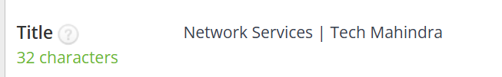
Tech mahindra – network service
Title tag

Slide 39
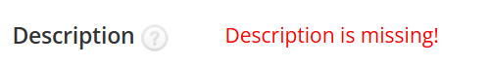

Tech mahindra – network service
Description tag

Slide 40
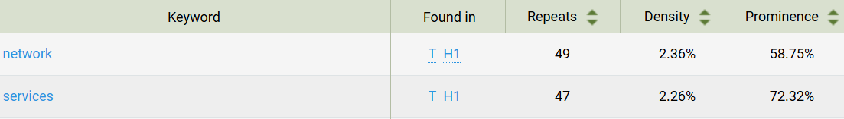
Tech mahindra – network service
Keywords

Slide 41
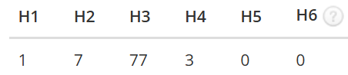
Tech mahindra – network service
Heading Tag

Slide 42
Tech mahindra – network service
Internal Links
External Links

Slide 43
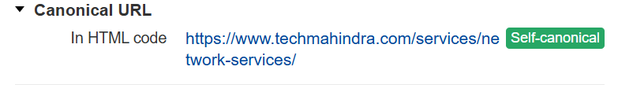
Tech mahindra – network service
Canonical Tag

Slide 44
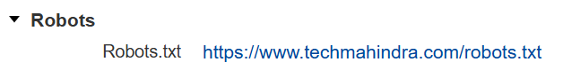
Tech mahindra – network service
Robot.txt

Slide 45
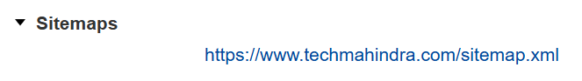
Tech mahindra – network service
Sitemap

Slide 46
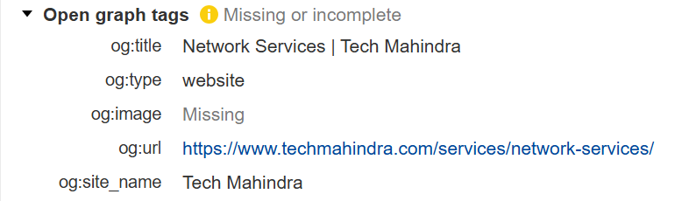
Tech mahindra – network service
Open Graph Meta Tag

Slide 47
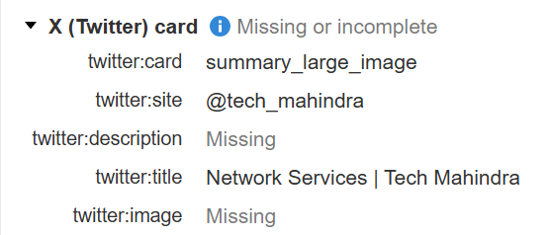
Tech mahindra – network service
Twitter Card Meta Tag

Slide 48
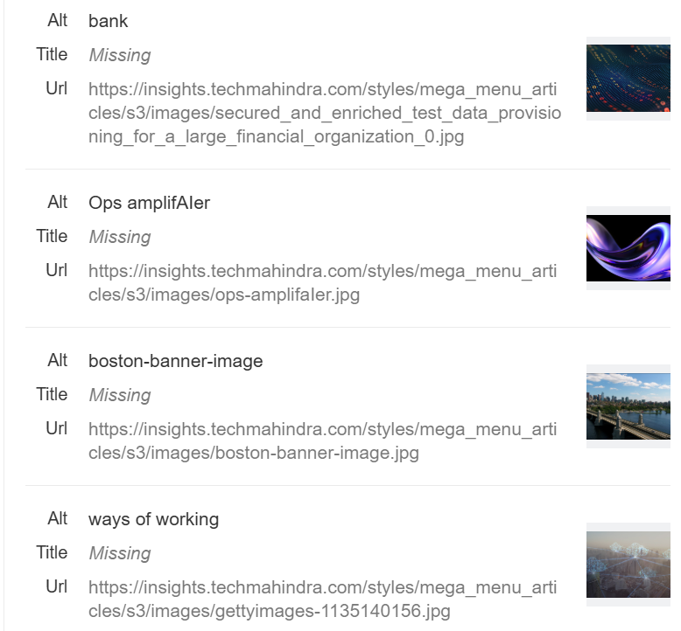
Tech mahindra – network service
Image Optimization

Slide 49
2. Testing services

Slide 50
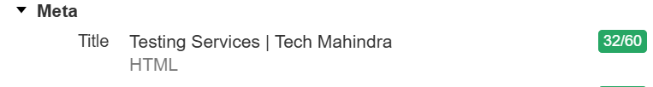
Tech mahindra – Testing Services
Title Tags

Slide 51


Tech mahindra – Testing Services
Description Tags

Slide 52
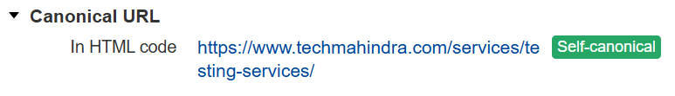
Tech mahindra – Testing Services
Canonical Tags

Slide 53
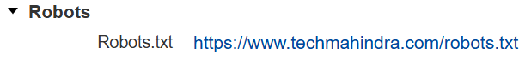
Tech mahindra – Testing Services
Robot.Txt

Slide 54
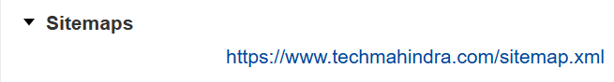
Tech mahindra – Testing Services
Sitemap

Slide 55
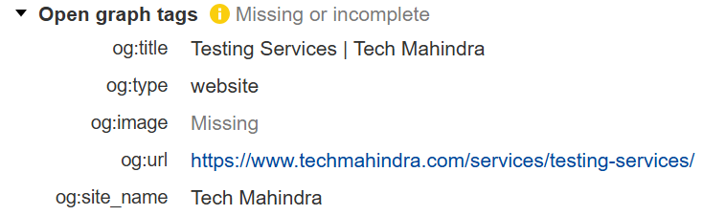
Tech mahindra – Testing Services
Open Graph Meta Tags

Slide 56
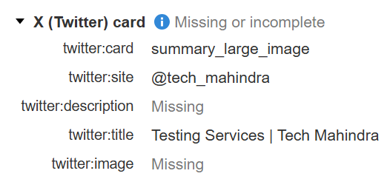
Tech mahindra – Testing Services
Twitter Card Meta Tags

Slide 57
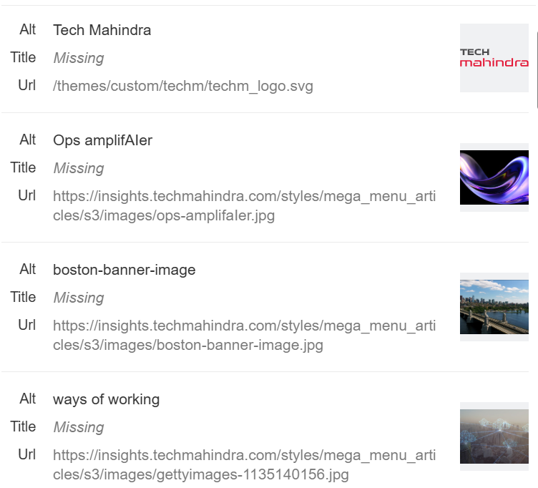
Tech mahindra – Testing Services
Image Optimization

Slide 58
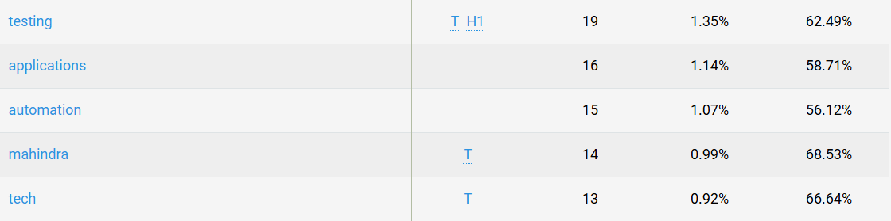
Tech mahindra – Testing Services
Keywords

Slide 59
Tech mahindra – Testing Services
Internal Links
External Links

Slide 60
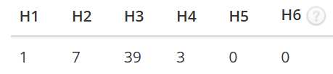
Tech mahindra – Testing Services
Heading Tags

Slide 61
Current Technical seo status

Slide 62

Metric | Status | Notes
HTTPS | Ok | Site is secure
Robots.txt | Ok | Found and accessible
Sitemap | Ok | Found at /sitemap.xml
Indexed Pages | 320 | Reasonable volume
Mobile-Friendly | No | Failed Google’s Mobile-Friendly Test
PageSpeed (Mobile) | 15 | Needs improvement
Speed Index | 20.1 s | Very slow

Slide 63
HOME PAGE
Twitter card - Missing
2 Image - Without Alt Tag
Keyword - Missing
Mobile friendly - Not
Speed index - Poor above 10s
Image size - High
Hfreflang - Missing

Slide 64
NETWORK SERVICES PAGE
Description - Missing
2 Image - Without Alt Tag
Hfreflang - Missing
Twitter card - Missing(desc & image)
Open graph - Missing(img)
Mobile friendly - Not
Speed index - Poor above 15s
PA - low

Slide 65
TESTING SERVICES PAGE
Description - Missing
7 Image - Without Alt Tag
Hfreflang - Missing
Twitter card - Missing(desc & image)
Open graph - Missing(img)
Mobile friendly - Not
Speed index - Poor above 5s
PA - low

Slide 66
5 BEST PRACTICES TO IMPROVE PAGE SPEED
Compress and reduce resize large image
Clean and Simplify the Website Design
Lazy Load Images and Videos
Use a Content Delivery Network (CDN)
Optimize Mobile Performance Separately

Slide 67
CONTENT STRATEGY

Slide 68
BUSINESS NETWORK SOLUTION
TOPICS:
Why Business Network Solutions Are Essential in 2025 – Tech Mahindra’s Expert View.
How to Choose the Right Business Network Solution for Your Company: A Guide by Tech Mahindra.
Top 5 Mistakes Companies Make When Choosing Network Solutions (and How Tech Mahindra Solves Them.
Digital Transformation Starts with the Network – Tech Mahindra Explains Why.
Business Network Solutions Explained: How Tech Mahindra Empowers Global Enterprises.

Slide 69
NETWORK SERVICES PROVIDERS
TOPICS:
How to Choose the Right Network Services Provider for Your Business Needs: A Guide by Tech Mahindra.
What Makes Tech Mahindra Different from Other Network Services Providers?
Tech Mahindra vs Other Network Services Providers: A Detailed Comparison.
Choosing the Right Network Partner: Why Enterprises Trust Tech Mahindra
Top 5 Reasons to Choose Tech Mahindra as Your Network Services Provider.

Slide 70
CLOUD BASED TESTING
TOPICS:
What Makes Tech Mahindra a Leader in Cloud-Based Testing Services?
Why Businesses Are Choosing Tech Mahindra for Cloud-Based Testing in 2025
Tech Mahindra’s Cloud-Based Performance Testing: A Game Changer for Web & Mobile Apps
Case Study: Tech Mahindra’s Cloud-Based Testing for High-Traffic E-commerce Platform
Tech Mahindra’s Vision for the Future of Cloud-Based Testing.

Slide 71
PERFORMANCE TESTING SERVICES
TOPICS:
Why Should You Choose Performance Testing Services from Tech Mahindra?
Case Study: How Tech Mahindra Solved Performance Issues for a Global Client
Tech Mahindra vs Other Vendors: Who Offers the Best Performance Testing Services?
Choosing Tech Mahindra as a Long-Term Performance Testing Partner: What to Consider
How Tech Mahindra Helps Startups Scale with Enterprise-Grade Performance Testing Services.ormance testing

Slide 72
seo STRATEGY & recommendation

Slide 73
PERFORMANCE TESTING SERVICES
1. Executive Summary
Keyword: "PERFORMANCE TESTING SERVICES“
Target company: Tech Mahindra
Content focus: Improving search rankings, attracting leads,
brand visibility, etc
This SEO strategy focuses on improving Tech Mahindra's organic visibility for the keyword.

Slide 74
PERFORMANCE TESTING SERVICES
2. Keyword Analysis
Keyword - "PERFORMANCE TESTING SERVICES“
Volume - 100 – 1k
Difficulty - Low
Intent - Transactional

Slide 75
PERFORMANCE TESTING SERVICES
3. Content Strategy
Blog topics
Suggested content formats (blogs, case studies, videos, articles)
Content frequency (e.g., 1 blog/week for 5 weeks)
CTA (e.g., “Explore More“,” Contact Tech Mahindra”)

Slide 76
PERFORMANCE TESTING SERVICES
3. Content Strategy
Blog topics
Why Should You Choose Performance Testing Services from Tech Mahindra?
Case Study: How Tech Mahindra Solved Performance Issues for a Global Client
Tech Mahindra vs Other Vendors: Who Offers the Best Performance Testing Services?
Choosing Tech Mahindra as a Long-Term Performance Testing Partner: What to Consider
How Tech Mahindra Helps Startups Scale with Enterprise-Grade Performance Testing Services. Performance testing

Slide 77
PERFORMANCE TESTING SERVICES
4. On-Page SEO Recommendations
Title tag
Meta description
Url Structure
Header Tags(H1,H2,H3)
Image Alt Text
Internal links
Language Tag

Slide 78
PERFORMANCE TESTING SERVICES
5. Technical SEO Recommendations
Check and fix:
Mobile-Friendliness test
Site Speed
Secure Connection
Broken links or crawl errors

Slide 79
PERFORMANCE TESTING SERVICES
6. Off-Page SEO Recommendations
Build authority and backlinks by:
Blog Submission
Article Submission
PPT Submission
Infographic Submission

Slide 80
PERFORMANCE TESTING SERVICES
6. Measurement Tool
Organic Traffic to Blog - Google Analytics
Keyword Position Tracking - Google Search Console
CTR - Google Search Console
Blog Engagement - Google Analytics

Slide 81
Thank You

